Slide 1


Introduction of
China Construction Bank
Cross-border Matchmaking
Business
China Construction Bank (DIFC Branch)
July 2020

Slide 2
Table of Contents
01
Cross-border Matchmaking Business
02
Match Plus Platform
03
Group Strength
04
Cross-border Matchmaking Team

Slide 3
01
Cross-border Matchmaking Business

Slide 4






What is Cross-border Matchmaking Business？
Aiming to solve key issues in cross-border trades, such as information asymmetry and high transaction costs
Systematic & Internet Mindset
Information Intermediary
Information Release Platform
Apply AI, Big Data, Cloud Computing and Other Advanced Technologies
Accurate Matching and Smart Filtering among Massive Data
Comprehensive and Integrated Financial Service Solutions

Slide 5
Roadmap of CCB Cross-border Matchmaking
Goal
Establish a global, intelligent and comprehensive cross-border ecosystem with domestic and overseas layout, online and offline integration, financial and non-financial connectivity.
3
Mode
“Technology-intensive, Intelligence-intensive”, “Online Dominant, Offline Supplementary ”, “Focus on key offline events and projects”
2
1
Foundation
Build smart cross-border matchmaking platform——CCB Match Plus

Slide 6



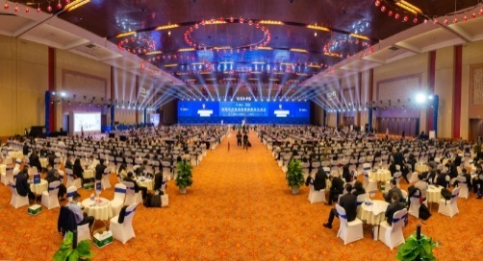
CCB Cross-border Matchmaking Services
Online Smart Matchmaking
Establishing Smart Matchmaking Platform, which integrates domestic and overseas, multi-channel and multi-dimensional data, to facilitate accurate data matching.
Online & Offline Coverage
Quality Client Base
Empower Market Players along “Belt & Road”
Empower market players along B&R and key participants in global economic and trade activities with new financial services and more transactions.
Offline Matchmaking Events
Leveraging CCB’s overseas network, to assist enterprises, industrial parks, financial institutions and other market players to reduce transaction costs and to improve resource allocation efficiency.

Slide 7
02
CCB Match Plus Platform

Slide 8
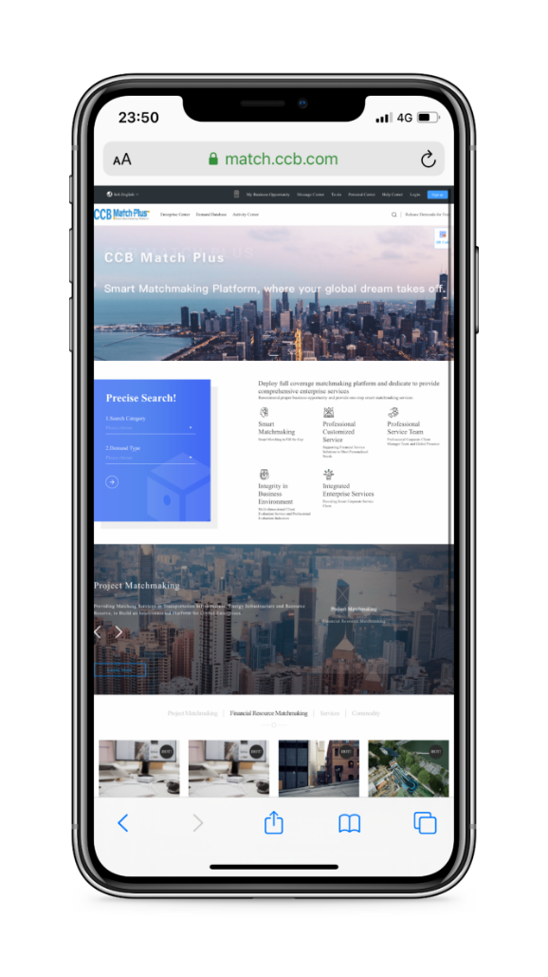


CCB Match Plus: Accessible Smart Eco-system
1. Project Matchmaking
Provide cross-border project matchmaking of transportation, infrastructure, resource, equipment and other key industries.
6.Financial Resources Matchmaking
Provide financial resources matchmaking in risk participation, forfeiting etc.
2. Merchandise Matchmaking
Support the release and matching of cross-border merchandise supply and demand
8.GD-HK-MO
Greater Bay Area
Support the release, display and matching of Greater Bay member cities, policies, finance and project information.
7. Belt & Road
Support the display and matching of project activities, country profile, news and data along B&R.
5.Cross-border Ecosystem
Provide one-stop online smart management for cross-border industrial parks.
4.Offline Events
Provide one-stop event management including event release, registration，sign-up and feedback.
3. Service Matchmaking
Provide cross-border matchmaking
of services including legal, accounting, logistics and warehousing etc.
9.Information Services
Support release of local policies, industrial information, public projects and consultancy services.

Slide 9




CCB Match Plus: Diversified Participants
Commerce Department
Government Agencies
Domestic & Overseas Enterprises
Embassies & Consulates
Corporate Clients
Cross-border Cooperation Zones
Financial Institutions
Intermediary Organizations
Chambers & Associations
Data Platform
Trade Promotion Organizations
Professional Service Providers
Professional Services
Academies
Incubators

Slide 10

CCB Match Plus: Strength
Domestic User
568,500+
Demands Released
899,500+
Matchmakings
52,900+
Sign-up Parks
26

Slide 11
CCB Match Plus: Bring the World within Reach
Log in
Search for Demands
Project
Release Demands
Matchmaking
Service
Business Negotiation
Merchandise
Reach Consensus
Sign Contract
Feedback

Slide 12
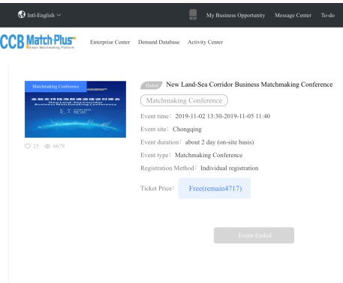
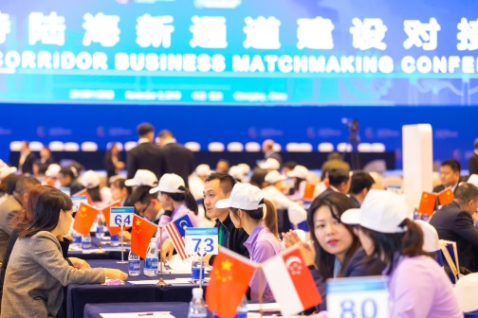
Offline Events： F2F with Global Partners
Events Details
Check Available Events
Registration
Fill in Registration Form Online
Arrangements
Check Events Schedule & Arrangements
Meetings
Make Appointments for meetings
Online Events Management
Offline Events
Invite Clients to Offline Matchmaking Conference, Forums and Exhibitions.
Sign in
Scan QR Code to Sign up
Face to Face Talks
F2F Business meetings according to Online Arrangements
Offline Events Participation

Slide 13
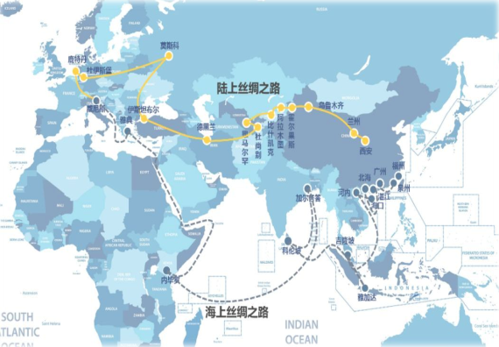
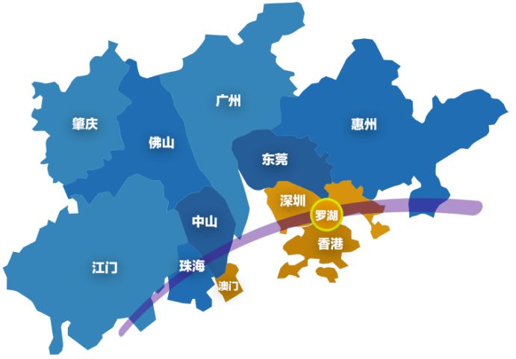
Featured Zone：Ride along with Growing Region
“Belt and Road”
Guangdong-Hong Kong-Macao
Greater Bay Area
Cross-border demand: display of related demands
Information service: display of related policies and economic data
Financial service cases: display cases of CCB's financial support to related projects and clients.

Slide 14

Project Matchmaking Advantages
Fulfill diversified needs for cross-border projects.
Extensive and flexible release of online demand
Massive and high-quality client base
Smart algorithm models and accurate matching with multiple elements input
One-stop access to professional financial solutions and full-fledged third-party services

Slide 15


Cross-border Parks：Smart Parks, Infinite Possibilities
Three types of cross-border cooperation zones (domestic international cooperation parks, overseas economic and trade cooperation parks, and border / cross-border economic cooperation zones) have developed rapidly;
Cross-border cooperation parks at different development stages correspond to differentiated development demands.
Provide online smart management and consultancy for cross-border cooperation zones under construction or in the early stages of development;
Provide transformation, upgrading services and financing for relatively mature zones, and promote industrial upgrading and innovative R & D cooperation.
DEMANDS
SOLUTIONS

Slide 16

Financial Resources Matchmaking:
Supporting the Real Economy with Financial Momentum
With international settlement (LC, LG) and trade financing (forfaiting, international factoring) as entry points, the platform will gradually cover cross-border investment, financing, asset transfer and other fields to facilitate financial resources allocation efficiency.

Slide 17




More to Expect……
Database
Access to Xinhua News Agency Overseas Data
Information Report
Database of Chinese enterprises
Economic ,Trade and Legal Database
Investment and Financing Risk Database
Case Studies
Global Information
Report of Global Views
Market & Quality Inspection, Key Events Analysis
Analysis and Report of Business Cases
Studies of Global Business Opportunities and Cases

Slide 18
03
CCB Group Strength

Slide 19



Globalized Comprehensive Financial Group
Strong Group Strength
Ranked 2nd among the world's top 1,000 banks in Tier 1 capital in 2018
Listed on Shanghai and Hong Kong Stock Exchanges
Pillar in China's Economy
Fully licensed financial services, including: commercial banking, asset management, financial leasing, trusts, life insurance, investment banking, futures and pensions.
Actively participate in major national strategic projects, including Belt & Road, the opening of financial markets, green finance and inclusive finance.
Global Financial Service
Overseas institutions cover major financial centers in Asia, Europe, America, Oceania and Africa.
More than 1400 global correspondent banks, covering 140 countries and regions.
Providing clearing services for nearly 30 currencies including RMB, USD, EUR, GBP, etc.
Notes:
年报

Slide 20
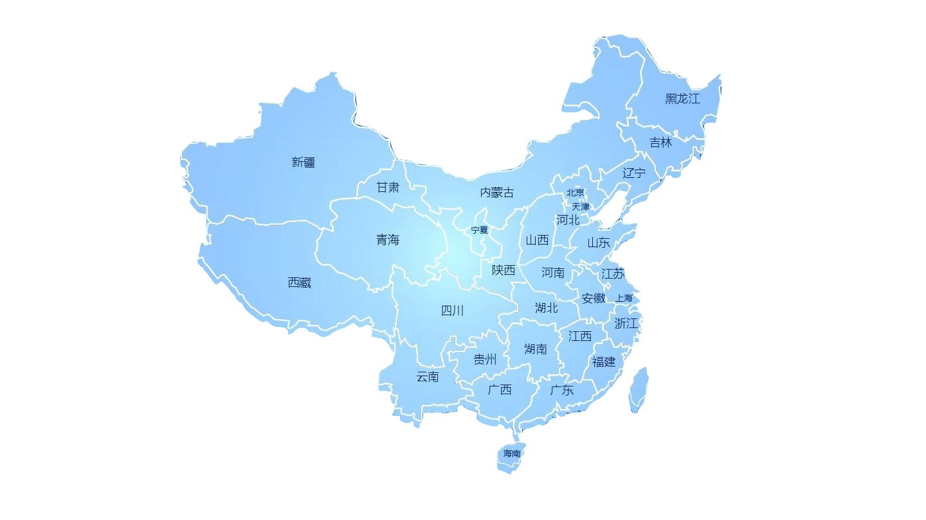




Solid Domestic Foundation
15,000 branches and 350,000 employees, providing financial services to over 400 million individuals and 5 million corporates
Inclusive Finance balance exceeded 631 billion yuan, ranking 1st among peers with an increase of 50.78%.
Innovate quick loan products to benefit 550,000 small and micro enterprises.。
Support China’s strategy and major project construction. Total infrastructure loan balance amounted to 3.46 trillion yuan.
Group Assets reached 23.22 trillion yuan, 4.96% YoY
Net Profit 255.63 billion yuan, 4.93% YoY
台湾
香港
澳门

Slide 21
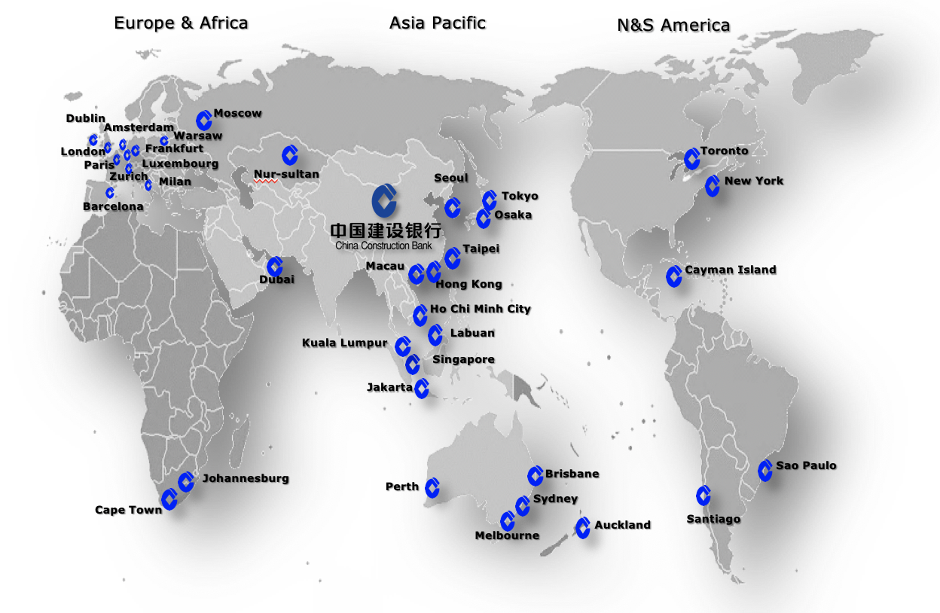
Extensive Global Coverage
More than 200 overseas entities covering 6 Continents, 30 countries & regions
Provide 14 minor currency clearing services along "Belt & Road”

Slide 22




CCB Fintech Strategy
Synergized Smart Finance internally
Open & Sharing Ecosystem externally
Facilitate national governance modernization
Tech Empower
AI
Internet
Blockchain
IoT
Cloud Computing
Big Data
Technology Application
Data Mining
Improve data governance
Enhance data value creation
Improve task segmentation & integration
Apply continuous integration & automated testing
Swiftly replicate, promote, iterate & update
Innovate & Iterate

Slide 23

Create a Shared Smart Ecology
CCB builds a proprietary platform, uses technology to enhance competitiveness, and establishes a shared smart ecosystem to cover a wider market space.
CCB contributes to the growth of China’s economic development and global financial inclusion, while fulfilling the social responsibility of big banks.

Slide 24
04
CCB Cross-border Matchmaking Team

Slide 25
https://match.ccb.com
Contacts
Ms. Lun Xin
Tel: 971-4567 4840
Email: lunxin@ae.ccb.com
Mr. Zhang Ta
Tel: 971-4567 4830
Email: zhangta@ae.ccb.com

